Slide 1

VeriSync - No more “trust me bro”
Presented by Aarav & Tarun

Slide 2

Agenda
TOPICS COVERED
Overview
Targeted Users
The Problem
The Solution

Slide 3

Overview
This application is a blockchain-based resume verification system that connects universities, students, and employers on a single secure platform.
It allows universities to upload and verify academic credentials on the blockchain, enabling students to create tamper-proof digital resumes.
Employers can instantly search and validate a candidate’s educational and professional history, ensuring trust, transparency, and authenticity in hiring.

Slide 4
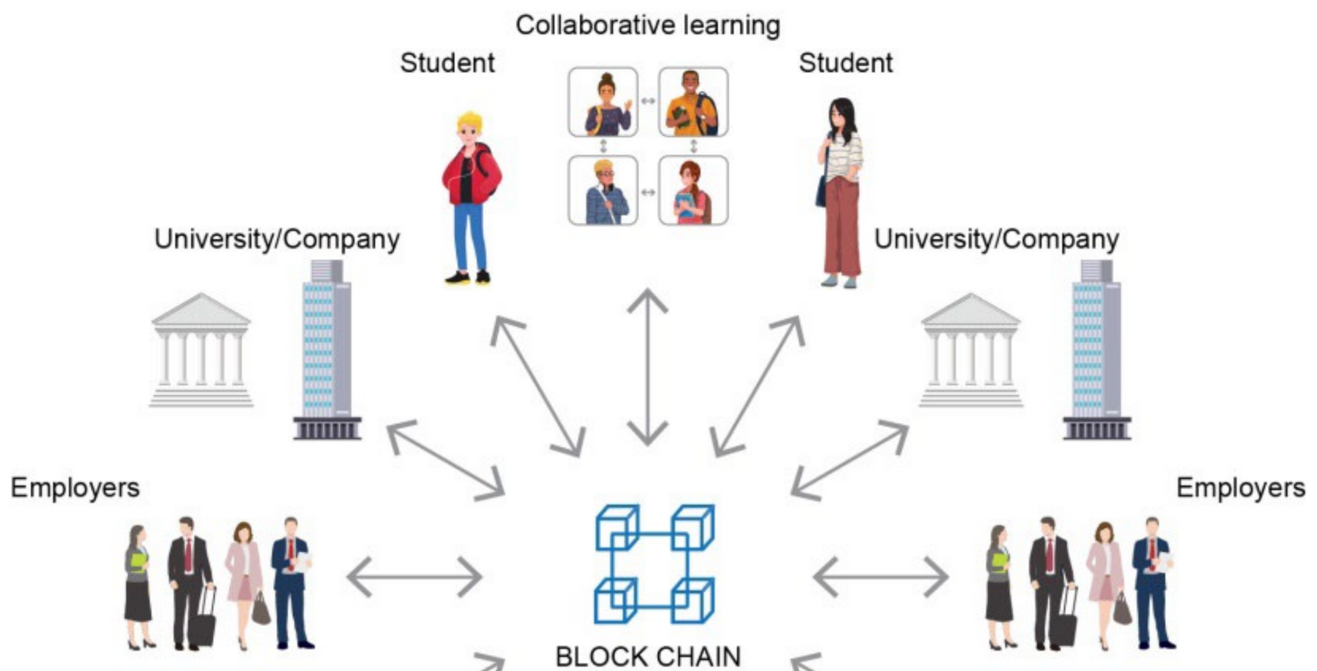
Students / Job Seekers
Create verified digital resumes using blockchain-validated credentials.
Control who can access their academic and professional data.
Employers / Recruiters
Instantly verify candidate credentials without third-party background checks.
Reduce hiring risks caused by fraudulent resumes.
Target Users
Government / Regulatory Agencies
Oversee and audit credential authenticity for compliance and trust.

Slide 5

Fake or Manipulated Resumes
Many candidates submit falsified degrees or experience.
Employers struggle to confirm authenticity quickly.
Time-Consuming Verification Process
Manual background checks are slow, expensive, and prone to error.
Each verification requires contacting multiple institutions.
Lack of Centralized & Trusted Platform
Universities, students, and employers operate in silos.
No unified system to verify credentials efficiently.
Data Tampering & Security Risks
Traditional databases can be altered or hacked.
Credentials lose credibility when not securely stored.
The Problem

Slide 6

The Solution:
VERISYNC

Slide 7



App Features
✅ Verified Credentials on Blockchain
Solves: Fake or manipulated resumes
⚡ Instant Verification System
Solves: Time-consuming background checks
🌐 Unified Digital Platform
Solves: Lack of centralized, trusted system
Universities issue verified degrees and certificates directly on the blockchain.
Ensures every record is authentic and cannot be altered.
Employers can instantly verify academic and employment details.
Eliminates third-party verification delays and costs.
Connects universities, students, and employers in one secure ecosystem.
Streamlines the credential-sharing process.

Slide 8
App Features
🔒 Immutable & Secure Data Storage
Solves: Data tampering and security issues
👤 Decentralized Identity Management
Solves:Overauthority to admins looking over at the data
Blockchain’s immutability ensures no unauthorized data changes.
All credentials remain permanently verifiable.
Each user has a unique blockchain ID (DID) to securely manage personal data.
Students control who can access their records.

Slide 9


Thank You

